Slide 1


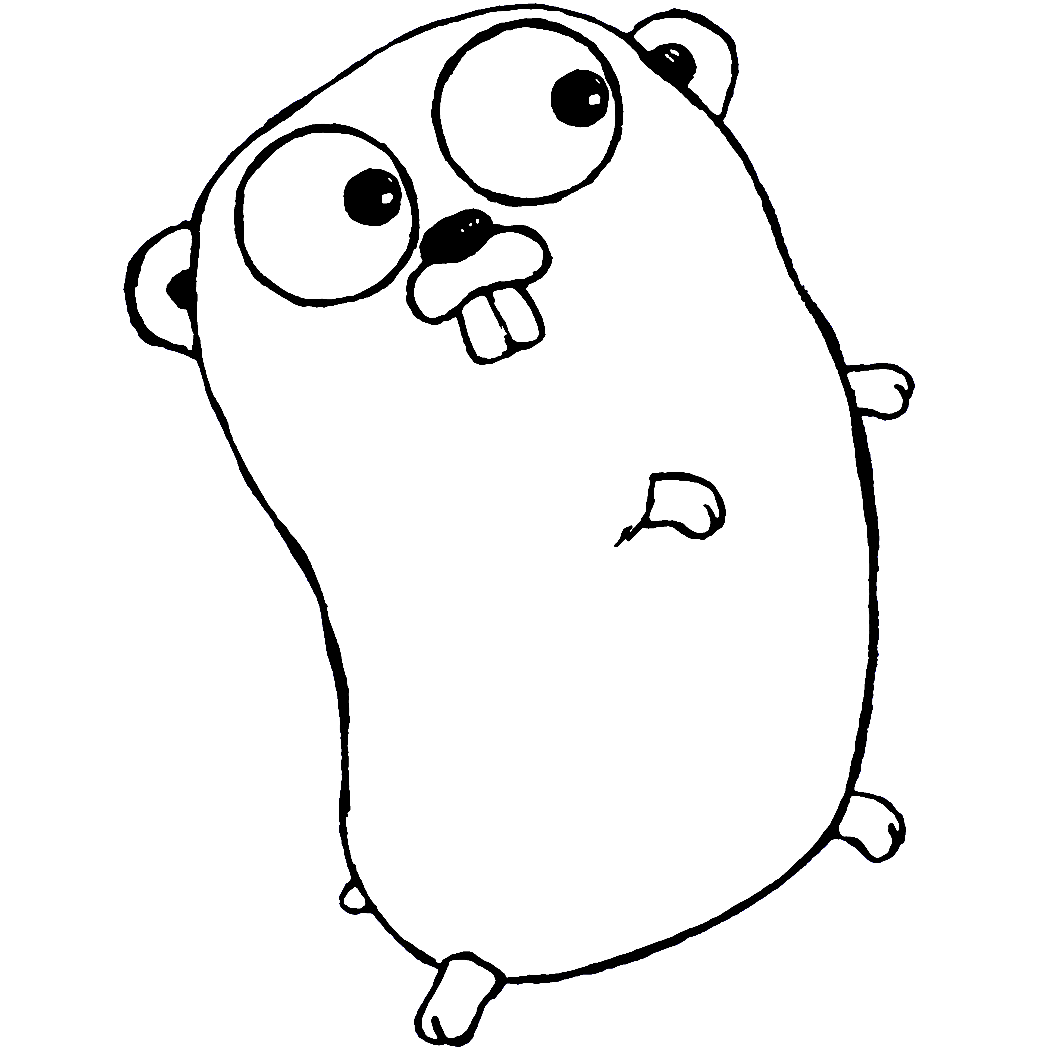



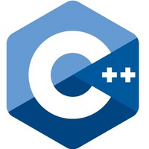



Programming Languages Compared

Slide 2
Chapter 1 – Installation/Setup
Installation of
Compilers
C, C++, Go, Groovy, Java, Scala, and Python
Editor/IDE
Visual Studio Code
Version Control – git

Slide 3
Section 1.1 – Course Overview
Go Language : https://golang.org/dl/
Scala : https://www.scala-lang.org/download/
Python : https://www.python.org/downloads/
Groovy : http://groovy-lang.org/download.html
Java : https://www.java.com/en/download/
C/C++ (windows): https://www.microsoft.com/en-us/download/developer-tools.aspx

Slide 4
Compilers & Interpreters
Go Language : https://golang.org/dl/
Scala : https://www.scala-lang.org/download/
Python : https://www.python.org/downloads/
Groovy : http://groovy-lang.org/download.html
Java : https://www.java.com/en/download/
C/C++ (windows): https://www.microsoft.com/en-us/download/developer-tools.aspx

Slide 5
Other Tools
Git SCM : https://git-scm.com/
VSCode Editor : https://code.visualstudio.com/download

Slide 6
VSCode Plugins
Auto-Open Markdown Preview (hnw)
C/C++ (Microsoft)
C/C++ snippets (Harsh)
Code Runner (Jun Han)
Diff Tool (jinshihou)
Go (lukehoban)
Language Support for Java(TM) by Red Hat (Red Hat)
Python (Don Jayamanne)
Scala (Lilya Tryapitsin)
TODO Parser (minhthai)

Slide 7
Course Material
Github Repo: https://github.com/xiliax/programming-languages-compared
$ mkdir lcp
$ cd lcp
$ git clone git@github.com:xiliax/programming-languages-compared.git

Slide 8
Section 1.2 – Mac OS X Setup
Pre-installed
Git*
Python*
Java*
Not Installed
Go
Groovy
Scala
Xcode & Clang (C/C++) - Available In AppStore
* Should install updated version

Slide 9
Section 1.3 – Linux Setup
Pre-installed
Python*
Not Installed - Available In Package Repository
Clang or GCC/G++ (C/C++)
Go
Groovy
Java+
Scala
*Should install updated version ---- ⁺Not in all distro repo.

Slide 10
Section 1.4 – Windows Setup
Pre-installed
Not Installed
Clang or Visual Studio* (C/C++)
Go
Groovy
Java
Python
Scala

Slide 11
Section 1.5 - VSCode Plugins Installation
Auto-Open Markdown Preview (hnw)
C/C++ (Microsoft)
C/C++ snippets (Harsh)
Code Runner (Jun Han)
Diff Tool (jinshihou)
Go (lukehoban)
Language Support for Java(TM) by Red Hat (Red Hat)
Python (Don Jayamanne)
Scala (Lilya Tryapitsin)
TODO Parser (minhthai)

Slide 12
Chapter 2 – Hello World
Print the string ‘Hello, World!’ on Standard out

Slide 13
Section 2.1 – Go, C, and C++
Print ‘Hello, World’ followed by a new line in Go, C, and C++.
Do not use a class for C++.

Slide 14
Section 2.2 – Java and C++
Print ‘Hello, World’ followed by a new line in Java and C++.
Must use a class for C++.

Slide 15
Section 2.3 – Groovy, Scala, and Python
Print ‘Hello, World’ followed by a new line in Groovy, Scala, and Python.

Slide 16
JVM (Java Virtual Machine) Illustrated
Java App
Groovy App
JVM
Scala App
OS (Linux, Mac, Windows, etc.)
non-JVM
Hardware

Slide 17
Section 2.4 – Review
A brief look at how programming languages have changed over time
Year first released
Language influenced

Slide 18
Section 2.4 – Language Chart
Name | Year Released | Age | Influenced By | Influenced
C | 1972 | 44 yrs | B (BCPL, CPL), Algo-68, Assembly, PL/I, Fortran | C++, C--, C#, Objective-C, D, Go, Java, Rust, Verilog
C++ | 1983 | 34 yrs | Ada, Algo-68, C, Simula | Ada-95, C#, C99, D, Java, Rust
Python | 1991 | 26 yrs | Algo-68, C, C++, Haskel, Java, List, Modula-3, Perl | CoffeeScript, D, F#, Go, Groovy, JavaScript, Julia, Nim, Ruby, Swift
Java | 1995 | 22 yrs | Ada-83, C++, C#, Eiffel, Modula-3, Objective-C, Object Pascal | Ada 2005, C#, Clojure, Groovy, J#, JavaScript, Kotlin, Python, Scala
Groovy | 2003 | 14 yrs | Java, Ruby, Perl, Smalltalk, Python | Kotlin
Scala | 2004 | 13 yrs | Java, Eiffel, Erland, Haskel, Lisp, Ocaml, Scheme, Smalltalk | Kotlin, F#
Go | 2009 | 7 yrs | C, C++, CSP, Limbo, Modula, Pascal, Smalltalk, Python | Crystal

Slide 19
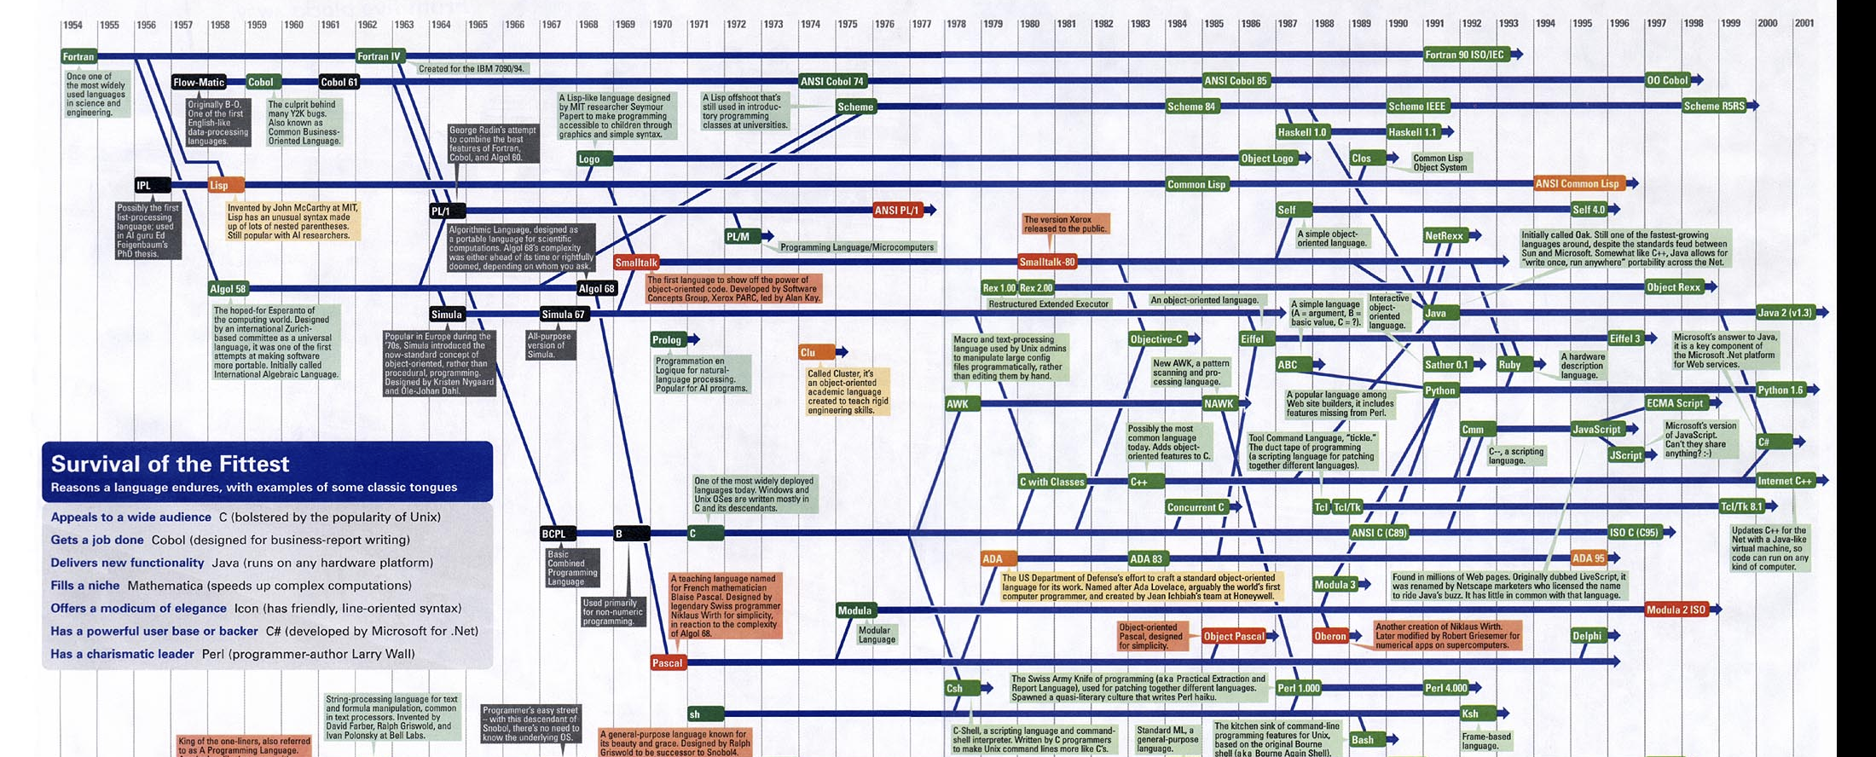
Section 2.4 – History of Programming Languages

Slide 20
Chapter 3 – Basic Types & Variables
Requirements:
Basic Types Available
Boolean
Byte
Character
Integer
Floating Point
Variable Declaration & Initialization:
Print Variables

Slide 21
Section 3.1
C Basic Data Types & Variables

Slide 22
Basics Data Types
Basic data types
Numeric
Character
Integral
Floating Point
Variables declaration and definition
Printing variables

Slide 23
Integer Data Types
Type | Storage Size | Values/Range
char, signed char | 1 byte | -128 to 127
unsigned char | 1 byte | 0 to 255
short, signed short | 2 bytes | -32,768 to 32,767
unsigned short | 2 bytes | 0 to 65,535
int, signed int | 2 or 4 bytes | -32,768 to 32,767 or -2,147,483,648 to 2,147,483,647
unsigned int | 2 or 4 bytes | 0 to 64,536 or 0 to 4,294,967,295
long, signed long | 4 bytes | -2,147,483,648 to 2,147,483,647
unsigned long | 4 bytes | 0 to 4,294,967,295

Slide 24
Float Types
Type | Storage Size | Values/Range | Precision
float | 4 bytes | 1.2E-38 to 3.4E+38 | 6 decimal places
double | 8 bytes | 2.3E-308 to 1.7E+308 | 15 decimal places
long double | 10 bytes | 3.4E-4932 to 1.1+4932 | 19 decimal places

Slide 25
Variable Declaration
Declaring variables
Basic Syntax
<type> <identifier>;
Ex: char age;
<type> <identifier> = <expression>;
Ex: char age = 35;
PIT FALL:
Unless initialized, a variable can have any value.

Slide 26
Section 3.2
C++ Basic Data Types & Variables

Slide 27
Basics Data Types
Basic data types
Boolean
Numeric
Character
Integral
Floating Point
Variables declaration and definition
Printing variables

Slide 28
Boolean Type
Keywords
bool, true, false
Type
bool
Values
true
false
PIT FALL:
Concrete type is really an int.

Slide 29
Integer Data Types
Type | Storage Size | Values/Range
char (signed) | 1 byte | -128 to 127
unsigned char | 1, 2, or 4 bytes | 0 to 255, 0 to 65535, or 0 to 1114111
short, signed short | 2 bytes | -32,768 to 32,767
unsigned short | 2 bytes | 0 to 65,535
int, signed int | 2 or 4 bytes | -32,768 to 32,767 or -2,147,483,648 to 2,147,483,647
unsigned int | 2 or 4 bytes | 0 to 64,536 or 0 to 4,294,967,295
long, signed long | 4 bytes | -2,147,483,648 to 2,147,483,647
unsigned long | 4 bytes | 0 to 4,294,967,295

Slide 30
Float Types
Type | Storage Size | Values/Range | Precision
float | 4 bytes | 1.2E-38 to 3.4E+38 | 6 decimal places
double | 8 bytes | 2.3E-308 to 1.7E+308 | 15 decimal places
long double | 10 bytes | 3.4E-4932 to 1.1+4932 | 19 decimal places

Slide 31
Variable Declaration
Declaring variables
Basic Syntax
<type> <identifier>;
Ex: char age;
PIT FALL:
Unless initialized, a variable can have any value.
<type> <identifier> = <expression>;
Ex: char age = 35;
auto <identifier> = <expression>;
Ex: auto age = 35;

Slide 32
Section 3.3
Go Basic Data Types & Variables

Slide 33
Basics Data Types
Basic data types
Boolean
Numeric
Character
Integral
Floating Point
Complex*
Variables declaration and definition
Printing variables

Slide 34
Boolean Type
Keywords
bool, true, false
Type
bool
Values
true
false

Slide 35
Types Aliases
Type | Storage Size | Values/Range
byte | 8-bits | Alias for uint8
rune | 32-bits | Alias for int32
uint | 32-bits or 64-bits
int | 32-bits or 64-bits
uintptr | - | Large enough to store a pointer value

Slide 36
Integer Data Types
Type | Storage Size | Values/Range
uint8 | 8-bits | 0 to 255
uint16 | 16-bits | 0 to 65535
uint32 | 32-bits | 0 to 4294967295
uint64 | 64-bits | 0 to 18446744073709551615
int8 | 8-bits | -128 to 127
int16 | 16-bits | -32768 to 32767
int32 | 32-bits | -2147483648 to 2147483647
int64 | 64-bits | -9223372036854775808 to 9223372036854775807

Slide 37
Floating-Point Types
Type | Storage Size | Values/Range
float32 | 32-bits | IEEE-754 32-bits floating-point number
float64 | 64-bits | IEEE-754 64-bigs floating-point number

Slide 38
Variable Declaration
Declaring variables
Basic Syntax
var <identifier> <type>;
Ex: var age byte;
var <identifier> [<type>] = <expression>;
Ex: var age = 35;
<identifier> := <expression>;
Ex: age := 35;
NOTE: Can only be used in a function or code block.

Slide 39
Section 3.4
Java Basic Data Types & Variables

Slide 40
Basics Data Types
Basic data types
Boolean
Numeric
Character
Integral
Floating Point
Variables declaration and definition
Printing variables

Slide 41
Boolean Type
Keywords
boolean, true, false
Type
boolean
Values
true
false

Slide 42
Integer Data Types
Type | Storage Size | Values/Range
char | 16-bits | -32768 to 32767
byte | 8-bits | -128 to 127
short | 16-bits | -32768 to 32767
int | 32-bits | -2147483648 to 2147483647
long | 64-bits | -9223372036854775808 to 9223372036854775807

Slide 43
Floating-Point Types
Type | Storage Size | Values/Range
float | 32-bits | IEEE-754 32-bits floating-point number
double | 64-bits | IEEE-754 64-bigs floating-point number

Slide 44
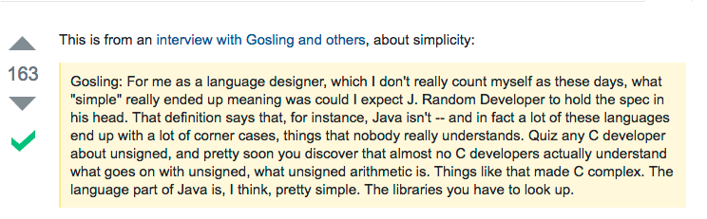
Why No Unsigned Types?

Slide 45
Variable Declaration
Declaring variables
Basic Syntax
<type> <identifier>;
Ex: byte age;
<type> <identifier> = <expression>;
Ex: byte age = 35;
NOTE: Variables MUST be initialized before use.

Slide 46
Section 3.5
Groovy Basic Data Types & Variables

Slide 47
Basics Data Types
Basic data types
Boolean
Numeric
Character
Integral
Floating Point
Variables declaration and definition
Printing variables

Slide 48
Boolean Type
Keywords
Boolean, true, false
Type
Boolean
Values
true
false

Slide 49
Integer Data Types
Type | Storage Size | Values/Range
Char | 16-bits | -32768 to 32767
Byte | 8-bits | -128 to 127
Short | 16-bits | -32768 to 32767
Int | 32-bits | -2147483648 to 2147483647
Long | 64-bits | -9223372036854775808 to 9223372036854775807

Slide 50
Floating-Point Types
Type | Storage Size | Values/Range
Float | 32-bits | IEEE-754 32-bits floating-point number
Double | 64-bits | IEEE-754 64-bigs floating-point number

Slide 51
Everything is an Object!!!
By default, Groovy wraps primitive types in an object.
Using a class to work with and represent a primitive type is sometimes called boxing and unboxing of the primitive types.

Slide 52
Variable Declaration
Declaring variables
Basic Syntax
<type> <identifier>
Ex: byte age;
<type> <identifier> = <expression>
Ex: byte age = 35;
def <identifier> = [value]
NOTE: Primitive types are wrapped in an object.
Since variables for primitive types are boxed, they get sensible default values.

Slide 53
Section 3.6
Scala Basic Data Types Variables

Slide 54
Basics Data Types
Basic data types
Boolean
Numeric
Character
Integral
Floating Point
Variables declaration and definition
Printing variables

Slide 55
Boolean Type
Keywords
Boolean, true, false
Type
Boolean
Values
true
false

Slide 56
Integer Data Types
Type | Storage Size | Values/Range
Char | 16-bits | -32768 to 32767
Byte | 8-bits | -128 to 127
Short | 16-bits | -32768 to 32767
Int | 32-bits | -2147483648 to 2147483647
Long | 64-bits | -9223372036854775808 to 9223372036854775807

Slide 57
Floating-Point Types
Type | Storage Size | Values/Range
Float | 32-bits | IEEE-754 32-bits floating-point number
Double | 64-bits | IEEE-754 64-bigs floating-point number

Slide 58
Everything is an Object!!!
Scala wraps primitive numeric types in an object.
Using a class to work with and represent a primitive type is sometimes called boxing and unboxing of the primitive types.

Slide 59
Variable Declaration
Declaring variables
Basic Syntax
var <identifier> = <expression>
Ex: var age = 35
var <identifier> : [type] = <expression>
Ex: var age : Byte = 35;
NOTE: All primitive variables must be assigned a value.
Since variables for primitive types are boxed, they get sensible default values.

Slide 60

Section 3.7
Python Basic Data Types Variables

Slide 61
Basics Data Types
Basic data types
Boolean
Numeric
Integral
Floating Point
Variables declaration and definition
Printing variables

Slide 62
Boolean Type
Keywords
bool, True, False
Type
bool
Values
True
False

Slide 63
Numeric Types
Python 2 | Python 3
bool | bool
int | int
long | int
float | float

Slide 64
Variable Declaration
Declaring variables
Basic Syntax
<identifier> = <expression>
Ex: age = 35
NOTE: All primitive variables must be assigned a value.
An exception is thrown when accessing a variable that isn’t defined.

Slide 65
Section 3.8
Review: Basic Data Types Variables

Slide 66
Boolean Type
Language | Built-in
C | No, uses 0 = false, !0 = true
C++ | Yes, but still use an integer, false = 0, true = 1
Go | Yes, true boolean values true and false
Java/Groovy/Scala | Yes, true boolean values true and false
Python | Yes, but false is a few different things. Which makes thinks even worst, since false can be False, 0, 0.0, {}, etc.

Slide 67
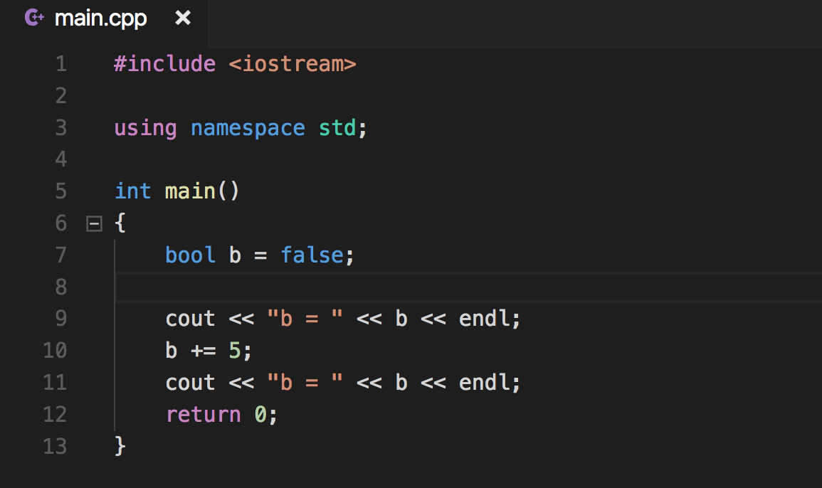
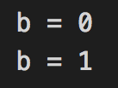
C++ Boolean

Slide 68
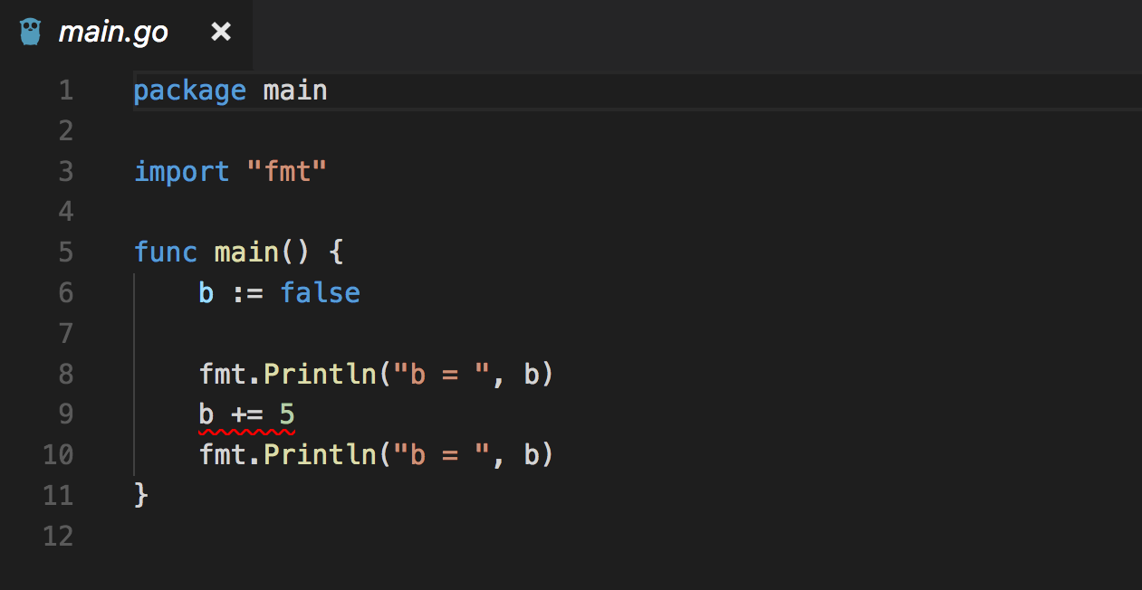
Go Boolean

Slide 69
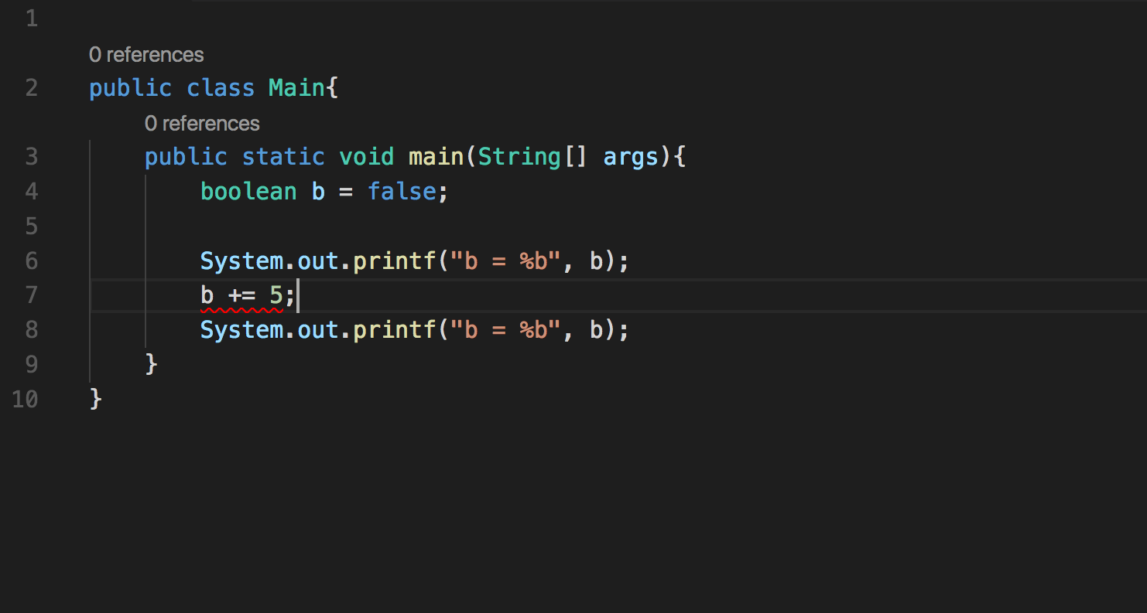
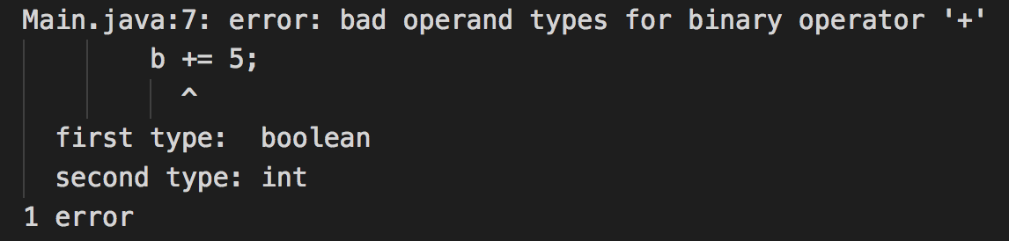
Java Boolean

Slide 70
Byte Type
Language | Built-in
C | Yes, char is 8-bits
C++ | Yes, char is 8-bits
Go | Yes, byte
Java/Groovy | Yes, byte or Byte class
Scala | Yes, Byte class
Python | No, but has bytearray

Slide 71
Character Type
Language | Built-in
C | Yes, char, 8-bits, but also has wchar
C++ | Yes, char, wchar and more
Go | Yes, rune which is 32-bits
Java/Groovy | Yes, char or Character class
Scala | Yes, Char class
Python | No

Slide 72
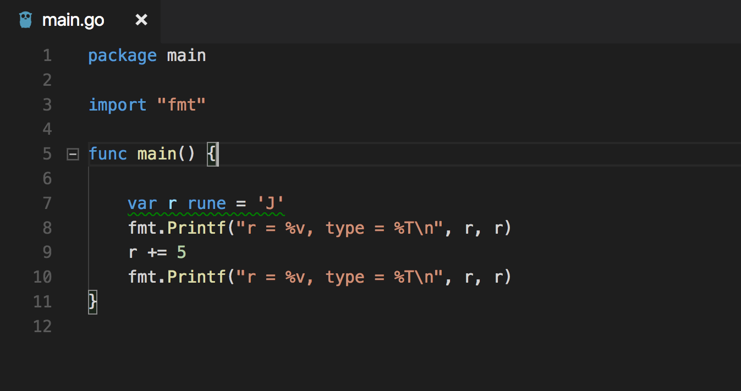
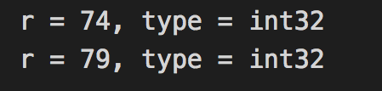
Go Character = Rune

Slide 73
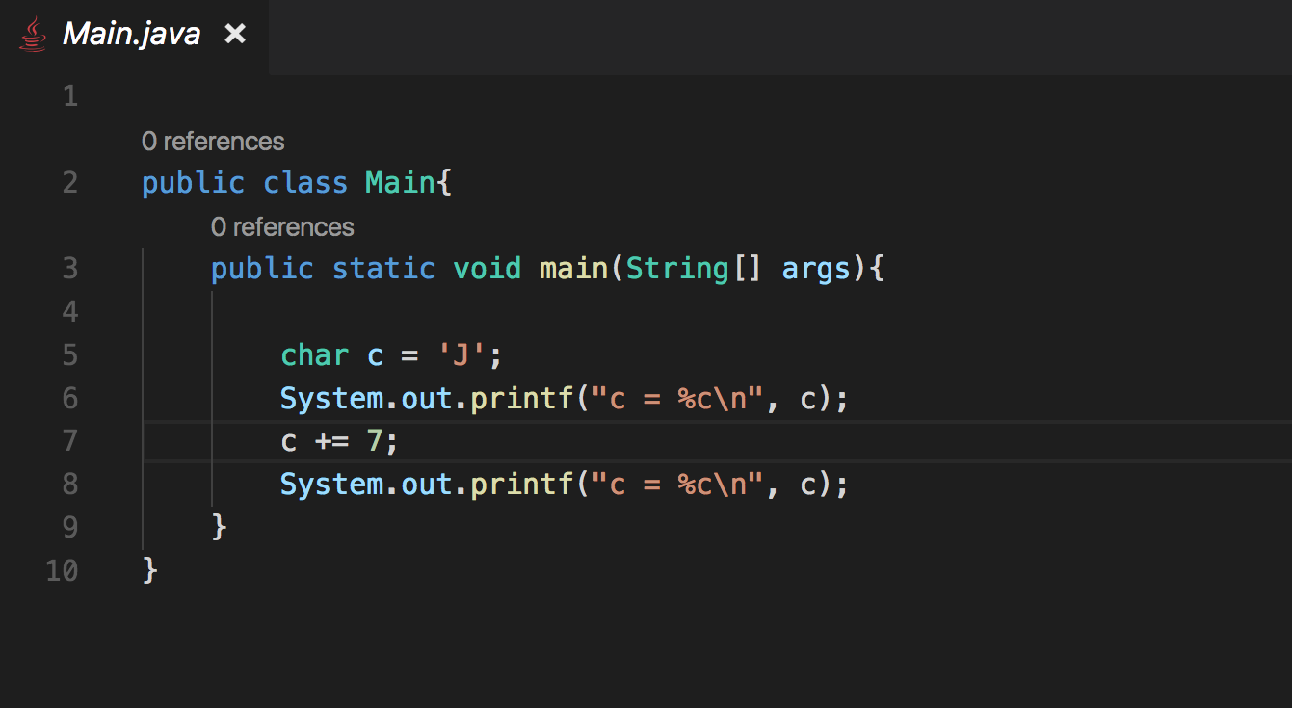
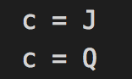
Java Char

Slide 74
Integer Type
Language | Built-in
C | Yes, short, int, long
C++ | Yes, short, int, long
Go | Yes, uintX/intX (X = 8, 16, 32, 64)
Java/Groovy | Yes, int, long, and Integer & Long classes
Scala | Yes, Int and Long classes
Python | Yes, int, long (Python 2 only)

Slide 75
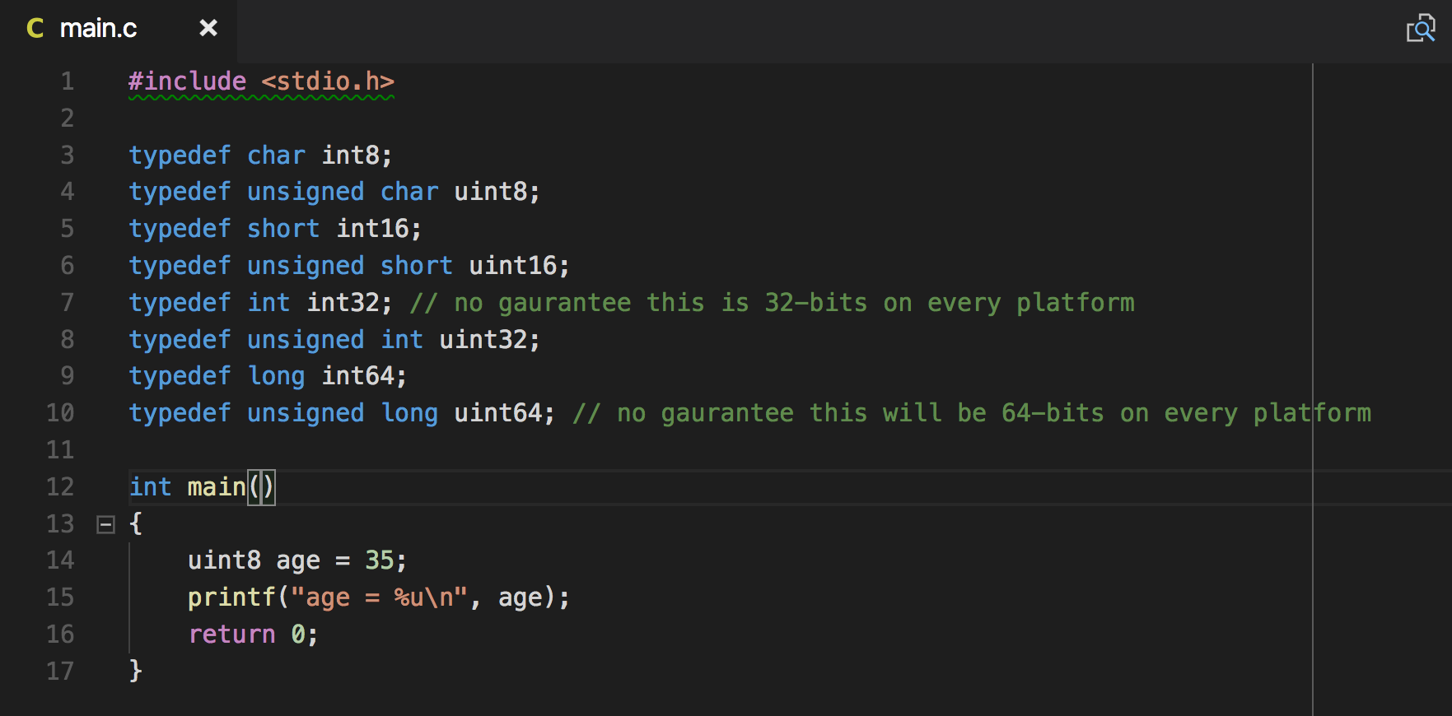
C Integer Typedef

Slide 76
Float Type
Language | Built-in
C | Yes, float, double
C++ | Yes, float, double
Go | Yes, float32, float64
Java/Groovy | Yes, float, double, Float & Double classes
Scala | Yes, Float & Double classes
Python | Yes, float

Slide 77
Chapter 4 – Application Structure
Source Code Structure and organization
Ways in which an application/program can be organized during development
Binary Code Organization
Runtime delivery of existing or reusable code

Slide 78
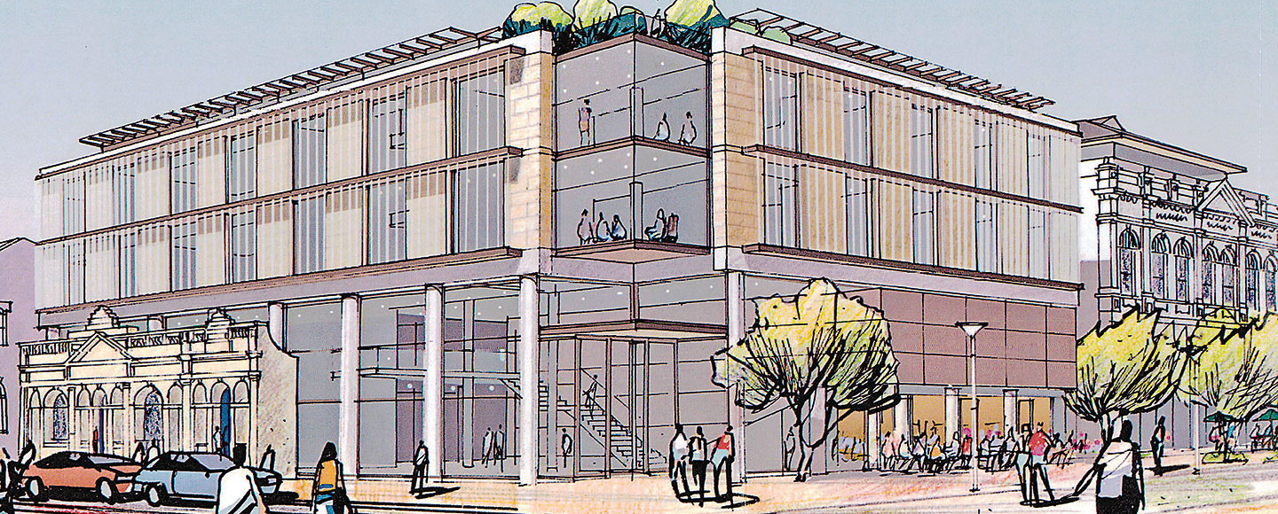
From The Outside

Slide 79
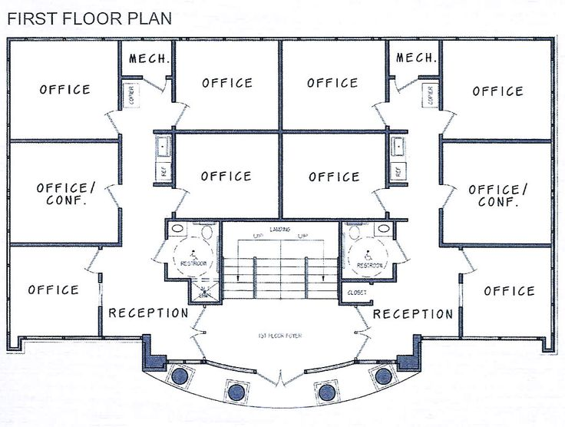
From The Inside

Slide 80
Logical Breakdown
Real World | Software World
Business | Program | C/C++ | Go | JVM | Python
Department | Modules | Library | Package | Package | Module
Groups/Teams | Sub-Modules | Struct/Classes (C++) | Sub-Packages | Classes | Classes
Employee | Function/Method | Function/Method | Function/Method | Method | Function/method

Slide 81
Section 1 – C
Requirements
Gather user input to drive the application
Get data from an SQL server
Do complex computation
Store result to file storage
Cleanup

Slide 82
Modules
App
UI
Storage
Compute
Common

Slide 83
Sub-Modules
App
UI
Storage
Compute
Common
GUI
Text
File
Net

Slide 84
Code Reuse
C provides the following for structuring application:
Source
.c files
#include directive
.h files
Binary
Object files
Archives
Libraries

Slide 85
Section 2 – C++
Requirements
Gather user input to drive the application
Get data from an SQL server
Do complex computation
Store result to file storage
Cleanup

Slide 86
Modules
App
UI
Storage
Compute
Common

Slide 87
Sub-Modules
App
UI
Storage
Compute
Common
GUI
Text
File
Net

Slide 88
Code Reuse
C provides the following for structuring application:
Source
.c files
#include directive
.h files
namespace
Binary
Object files
Archives
Libraries

Slide 89
Section 3 – Go
Requirements
Gather user input to drive the application
Get data from an SQL server
Do complex computation
Store result to file storage
Cleanup

Slide 90
Packages
App
UI
Storage
Compute
main

Slide 91
Sub-Packages
App
UI
Storage
Compute
main
GUI
Text
File
Net

Slide 92
Code Reuse
Go provides the following for structuring application:
Source
.go files
Packages
A package contains one or more .go files
Binary
Packages
Compiles all .go files in a package to .a file

Slide 93
Section 4 – Java, Groovy, Scala
Requirements
Gather user input to drive the application
Get data from an SQL server
Do complex computation
Store result to file storage
Cleanup

Slide 94
Packages
App
UI
Storage
Compute
Common

Slide 95
Sub-Packages
App
UI
Storage
Compute
Common
GUI
Text
File
Net

Slide 96
Java Code Reuse
Java provides the following for structuring application:
Source
.java files
Packages - A package contains one or more .java files
Binary
.class files – intermediate ‘platform independent’ byte code for JVM
.jar files
Archive of .class files, regardless of the package the .class belongs to

Slide 97
Groovy Code Reuse
Groovy provides the following for structuring application:
Source
.java and .groovy files
Packages - A package contains one or more .java/.groovy files
Binary
.class files – intermediate ‘platform independent’ byte code for JVM
.jar files
Archive of .class files, regardless of the package the .class belongs to

Slide 98
Scala Code Reuse
Scala provides the following for structuring application:
Source
.java and .scala files
Packages - A package contains one or more .java/.scala files
Binary
.class files – intermediate ‘platform independent’ byte code for JVM
.jar files
Archive of .class files, regardless of the package the .class belongs to

Slide 99
Source files
Jar file (.jar)
Pacakge A
Pacakge B
Pacakge A
Pacakge B
.java
.java
.class
.class
.groovy
.groovy
.class
.class
.scala
.scala
.class
.class

Slide 100
Class Path = path1:path2:path3
Classes | Import Statement
<path1>/ui/UITypes.class | import ui.UITypes;
<path2>/ui/text/TextPrompter.class | import ui.text.TextPrompter;
<path3>/storage/SQLStore.class | import storage.SqlStore;

Slide 101
Class Path = path1/ui.jar:path2/ui_text.jar:path3/storage.jar
Classes | Import Statement
<path1>/ui.jar → ui/UITypes.class | import ui.UITypes;
<path2>/ui_text.jar → ui/text/TextPrompter.class | import ui.text.TextPrompter;
<path3>/storage.jar → storage/SQLStore.class | import storage.SqlStore;

Slide 102
Section 5 – Python
Requirements
Gather user input to drive the application
Get data from an SQL server
Do complex computation
Store result to file storage
Cleanup

Slide 103
Package
App
UI
Storage
Compute
Common

Slide 104
Sub-Packages & Modules
App
UI
Storage
Compute
Common
GUI
Text
File
Net

Slide 105
Python Code Reuse
Python provides the following for structuring application:
Source
.py files
Module – is a file which contains functions, classes, etc.
Package – contains one or more modules
Binary
.pyc – precompiled python code

Slide 106
Source files
Packages
Pacakge A
Pacakge B
Pacakge A
Pacakge B
modA.py
modC.py
.pyc
.pyc
modB.py
modD.py
.pyc
.pyc
modC.py
modA.py
.pyc
.pyc

Slide 107
Package Path = path1:path2:path3
Classes | Import Statement
<path1>/ui.py | Import ui
<path2>/ui/__init__.py | import ui
<path3>/ui/text/simple.py -> TextPrompter | from ui.text import simple

Slide 108
Section 6 – Review
Code Organization & Abstraction
How to manage large applications
Reusable code
Reusing or sharing existing code
Language extension
Adding or enhancing features of a language

Slide 109
Standard vs Non-Standard Libraries
Language Specification
Community
Core
Standard Library
Libraries
primitives
thread
AI
Big Data
string
bool

Slide 110
Chapter 5 – Complex Numbers
Requirements:
Given two complex numbers ‘a’ and ‘b’:
Perform basic operation:
Add
Multiply
Pow
Print complex numbers

Slide 111
Section 1 – C
Complex numbers in C
Using Complex Numbers
Thoughts on C as a numerical language

Slide 112
Section 2 – C++
Complex numbers in C
Using Complex Numbers
Thoughts on C as a numerical language

Slide 113
Section 2 – C++
Using Complex Number
Include <complex> header
Operations
Prototype provided in <complex> header
Implementation provided in library
Language support
Standardized as a class, not a built-in type

Slide 114
Section 2 – Simple Operations
Requirements:
Given two complex numbers ‘a’ and ‘b’:
Perform basic operation:
Add
Multiply
Pow
Print complex numbers

Slide 115
Section 3 – Go
Using Complex Number
3 + 4i
complex(3, 4)
Operations
Advance math operation for complex numbers are in the ‘math/cmplx’ package
Language support
built-in type

Slide 116
Section 3 – Simple Operations
Requirements:
Given two complex numbers ‘a’ and ‘b’:
Perform basic operation:
Add
Multiply
Pow
Print complex numbers

Slide 117
Section 4 – Complex Numbers in Java
Using Complex Number
Complex(3, 4)
Operations
All math operations, basic and advance, are defined on the class Complex
Complex c = b.add(a);
Language support
Not a built-in type

Slide 118
Section 4 – Simple Operations
Requirements:
Given two complex numbers ‘a’ and ‘b’:
Perform basic operation:
Add
Multiply
Pow
Print complex numbers

Slide 119
Section 5 – Complex Numbers in Groovy
Using Complex Number
Complex(3, 4)
Operations
All math operations, basic and advance, are defined on the class Complex
Complex c = b.add(a);
Complex d = a + b;
Language support
Not a built-in type

Slide 120
Section 5 – Simple Operations
Requirements:
Given two complex numbers ‘a’ and ‘b’:
Perform basic operation:
Add
Multiply
Pow
Print complex numbers

Slide 121
Section 6 – Complex Numbers in Scala
Using Complex Number
Complex(3, 4)
Operations
All math operations, basic and advance, are defined on the class Complex
Complex c = b.add(a);
Complex d = a + b;
Language support
Not a built-in type

Slide 122
Section 6 – Simple Operations
Requirements:
Given two complex numbers ‘a’ and ‘b’:
Perform basic operation:
Add
Multiply
Pow
Print complex numbers

Slide 123
Section 7 – Complex Numbers in Python
Using Complex Number
3 + 4j
Operations
All math operations, basic and advance, are defined on the class Complex
c = b * a
d = a + b
Language support
Built-in type

Slide 124
Section 7 – Simple Operations
Requirements:
Given two complex numbers ‘a’ and ‘b’:
Perform basic operation:
Add
Multiply
Pow
Print complex numbers

Slide 125
Chapter 6 – Arrays
Requirements:
Declare
Initialize
Print
Operation/Manipulation:
Calculate Length
Basic Usage (assign, retrieve, iteration)
Split
Join/Grow
Restrictions:

Slide 126
Section 1 – Arrays in C
Supportability:
Language Support (built-in)
Basic operations
Pitfalls:
Collapses arrays into pointers
Very low level

Slide 127
Section 1.1 – Arrays in C
Requirements:
Declare
Initialize
Print
Operation/Manipulation:
Calculate Length
Basic Usage (assign, retrieve, iteration)
Split
Join/Grow
Restrictions:

Slide 128
Section 1.2 – Declaring & Initialization
Declaration:
<type> identifier[size];
<type> *identifier;
Initialization:
<type> identifier[size] = {el, el, el, …, el};
<type> identifier[] = {el, el, el, …};
<type> *identifier =
malloc(sizeof(<type>) * <num-elements>);

Slide 129
Section 1.2.1 – Dynamic Memory Allocation
0 = 0x00
16 = 0x10
32 = 0x20
Unused/free
48 = 0x30
Used/allocated
64 = 0x40
80 = 0x50
96 = 0x60
112 = 0x70
Address
Memory

Slide 130
Section 1.2.2 – Dynamic Memory Allocation
<type> *identifier = malloc(sizeof(<type>) * <num-elements>);
Eg: int *ar = malloc(sizeof(int) * 4); => malloc(4 * 4); => malloc(16);
ar = 0x20
0 = 0x00
16 = 0x10
32 = 0x20
Unused/free
48 = 0x30
Used/allocated
64 = 0x40
Newly allocated
80 = 0x50
96 = 0x60
112 = 0x70
Offset/Address
Memory

Slide 131
Section 1.2.3 –Memory Manipulation
Allocate memory:
Eg: char *ca= malloc(sizeof(char) * 16);
ca = 0x20
32 = 0x20
Minipulation:
6th element:
ca[5]
*(ca+ 5)
char *z = ca + 5
*z
*(z+0)
z[0]
ca = 0x20
ca[5] = 0x25
z = 0x25

Slide 132
Section 1.2.4 –Memory Manipulation
Allocate memory:
Eg: int *ia= malloc(sizeof(int) * 4);
ia = 0x20
32 = 0x20
16 bytes
Minipulation:
3th element:
ia[2]
*(ia+ 2)
int *z = ia + 2
*z
*(z+0)
z[0]
ia = 0x20
ia[5] = 0x28
z = 0x28

Slide 133
Section 1.3 – Arrays in C
Printing an array:
Not built-in
Operation/Manipulation
Length calculation
sizeof() – but be careful
Basic Usage:
array[i] ⬅➔ *(array + i)
Assignment:
array[i] = value;
Retrieval:
identifier = array[i];
Operation/Manipulation:
Split - nope
Join/Grow – possible, but be careful
Restrictions:

Slide 134
Section 1.4.1 –Multiple Dimension Arrays
Array of Array:
Eg: char *names[] = …;
names = 0x20
…
32 = 0x20

Slide 135
Section 1.4.2 –Multiple Dimension Arrays
Array of Array:
Eg: char *names[] = …;
names = 0x20
…
32 = 0x20
…
0x10AB96
…
0x4A00
…
0x12A0
…
0xFA88
…

Slide 136
Section 1.4.3 –Multiple Dimension Arrays
Array of Array:
Eg: char *names[] = …;
names = 0x20
…
32 = 0x20
…
0x10AB96
…
0x4A00
…
0x12A0
…
0xFA88
…

Slide 137
Section 1.4.4 –Multiple Dimension Arrays
Array of Arrays:
Eg: char **names[] = …;
names = 0x20
…
32 = 0x20
…
0x10AB96
…
0x4A00
…
names[0][0] = “Jones, Mary”;
names[0][1] = “Jones, Tom”;
names[1][0] = “Smith, Anne”;
names[2][0] = “Doe, Jane”;
names[2][1] = “Doe, John”;
0x12A0
…
0xFA88
…

Slide 138
Programming Languages Compared

Slide 139
Chapter 4 – Strings
Requirements:
Operations/Manipulation:
Calculate length
Split
Join
Replace
Restrictions:
TIPs:
Showcase

Slide 140
Chapter 5 – Map & Dictionary
Print the string ‘Hello, World!’ on Standard out

Slide 141
Chapter 6 – Compound Types
Requirements:
Store a complex number
Store a user’s name, age, height, and date of birth
Restrictions:
TIPS:
UDT
Tuples
Structs

Slide 142
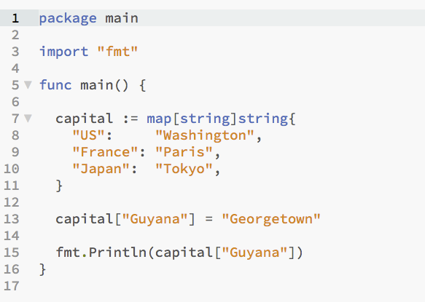
Go

Slide 143
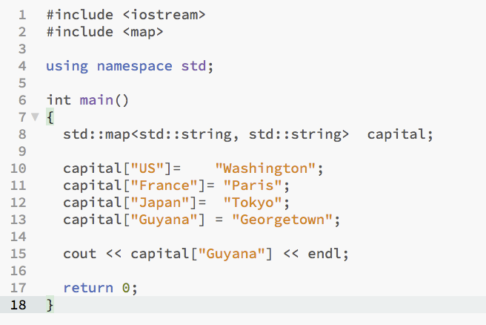
C++

Slide 144
Reference

